Slide 1
Basic Electronics Engineering FE 2024 Course
Presented by
Mr. Aniruddha Nirmal
Assistant Professor
Department of First Year Engineering
DPCOE Pune

Slide 2
Unit 5 (i) : Sensors
Syllabus
Classification of sensors
Active /Passive Sensors
Analog/Digital Sensors
Motion Sensors (LVDT)
Temperature Sensors (Thermocouple, Thermistor, RTD)
Mechanical Sensors (Strain Gauge)
Biosensors (Working Principle and one application)

Slide 3
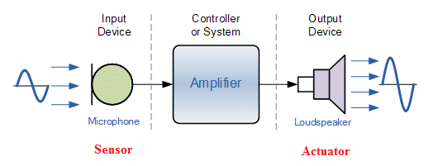
Sensors:
Sensor: A sensor is a device which detects one form of energy and produces corresponding electrical signal.
Transduces: A transducer is a device that converts one form of energy into another form of energy.
Thus sensor is type of transducer.
Sensors - Devices which perform an “Input” function are commonly called Sensors because they “sense” a physical change in some characteristic that changes in response to some excitation, for example heat or force and covert that into an electrical signal.
Actuators: Devices which perform an “Output” function are generally called Actuators and are used to control some external device, for example movement or sound.

Slide 4
Classification of Sensors
Sensors
(Based upon)
transduction principle
form of output
direct/indirect sensing of measurand
Need of excitation for obtaining voltage / Current output
A) Based upon - Transduction principle used:
Resistive Sensor: output is the change in their resistance (R) corresponding to change in measurand.
Example: Resistance Temperature Detector (RTD), Strain gauge, Thermistor.
Capacitive Sensor: output is the change in their capacitance (C) corresponding to change in measurand.
Example: Gang capacitor, Parallel plate capacitor
Inductive Sensor: output is the change in their inductance (L) corresponding to change in measurand.
Example: Linear Variable Differential Transformer (LVDT).
Piezoelectric Sensor: converts pressure signal into electrical signal.
Example: Quartz crystal
Thermoelectric Sensor: converts thermal energy into voltage signal.
Example: Thermocouple.
Photoelectric/Photovoltaic (Optical) Sensor: has change in electrical properties due to incident light.
Example: LDR, Photodiode, Photo transistor, Solar cell.

Slide 5
Sensors:
B) Based upon - Need of excitation for obtaining voltage/current output:
Active sensor: Active sensor is sensor which does not require any external energy to generate voltage/current output upon applying input measurand.
Example: Thermocouple, Piezoelectric Sensor, Solar cell
Passive sensor: Passive sensor is sensor which requires external energy to generate voltage/current output upon applying input measurand.
Example: (R,L,C) Sensor, RTD, LVDT, LDR, Strain gauge.
C) Based upon – Direct/Indirect sensing of measurand:
Primary sensor: Primary sensor is a sensor which accepts measurand as input and converts it into another quantity corresponding to input.
Example: LVDT for displacement measurement, Strain gauge for pressure measurement.
Secondary sensor: Secondary sensor is sensor which accepts output of primary sensor as input and converts it into another quantity
Example: LVDT for pressure measurement, LVDT for accelerometer.
D) Based upon – form of output:
Analog sensor: Analog sensor is a sensor whose output is in analog form (graph or waveform).
Example: LVDT, Strain gauge, Thermocouple.
Digital sensor: Digital sensor is a sensor whose output is in digital form (digital code).
Example: Rotary and absolute encoders, Stroboscope.

Slide 6
Comparison between active & passive sensors:
Active sensor | Passive sensor
They don’t require any external power or energy. | They require external power or energy.
They produce V or I signal which is proportional to the physical quantity to be measured. | They produce variations in R, L, C w.r.t. the physical quantity to be measured
They are simple | They are complex
Size is small | Size is bulky
Less expensive | More expensive
Examples: Thermocouple, Piezoelectric devices, Photovoltaic cells etc. | Examples: Variable (R,L,C), LDR, RTD, LVDT etc.

Slide 7
Comparison between Analog & Digital sensors:
Analog sensor | Digital sensor
Output is in analog form | Output is in digital form
Can be directly measured | One line can transmit multiple sensors
No compatibility issues | Need to interpret the 1’s and 0’s
More prone to noise | Need to make sure clocks a synced up
Ex. LVDT, Strain gauge, Thermocouple | Rotary and absolute encoders, Stroboscope
Output is in analog form | Output is in digital form

Slide 8
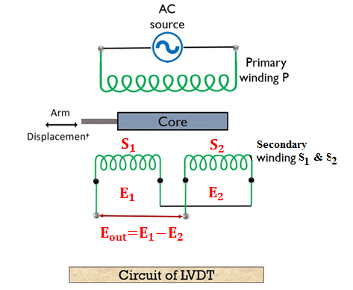
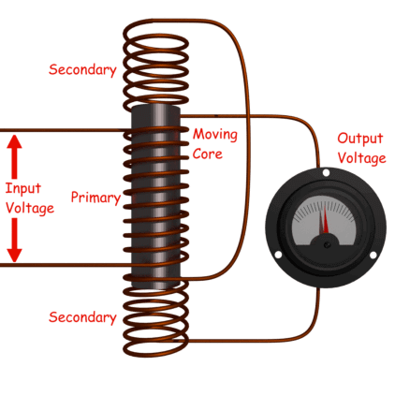
#Linear variable differential transformers (LVDT): motion sensor
LVDT - Linear Variable Differential Transformer.
It is inductive transducer that converts the linear motion into the electrical signal.
LVDTs are used to measure displacement.
The o/p across secondary of this transformer is the differential.
LVDT consists of a coil assembly and a core.
Magnetic flux produced by the primary is coupled to the two secondary coils, inducing an AC voltage in each coil.

Slide 9
LVDT:
Main Features of Construction:
The LVDT consists of a primary winding P and two secondary windings S₁ and S₂ wound on a cylindrical former (which is hollow in nature and contains the core).
Both the secondary windings have an equal number of turns, and we place them on either side of primary winding
The primary winding is connected to an AC source which produces a flux in the air gap and voltages are induced in secondary windings.
A movable soft iron core is placed inside the former and displacement to be measured is connected to the iron core.
The iron core is generally of high permeability which helps in reducing harmonics and high sensitivity of LVDT.
The LVDT is placed inside stainless steel housing because it will provide electrostatic and electromagnetic shielding.
The both the secondary windings are connected in such a way that resulted output is the difference between the voltages of two windings.

Slide 10
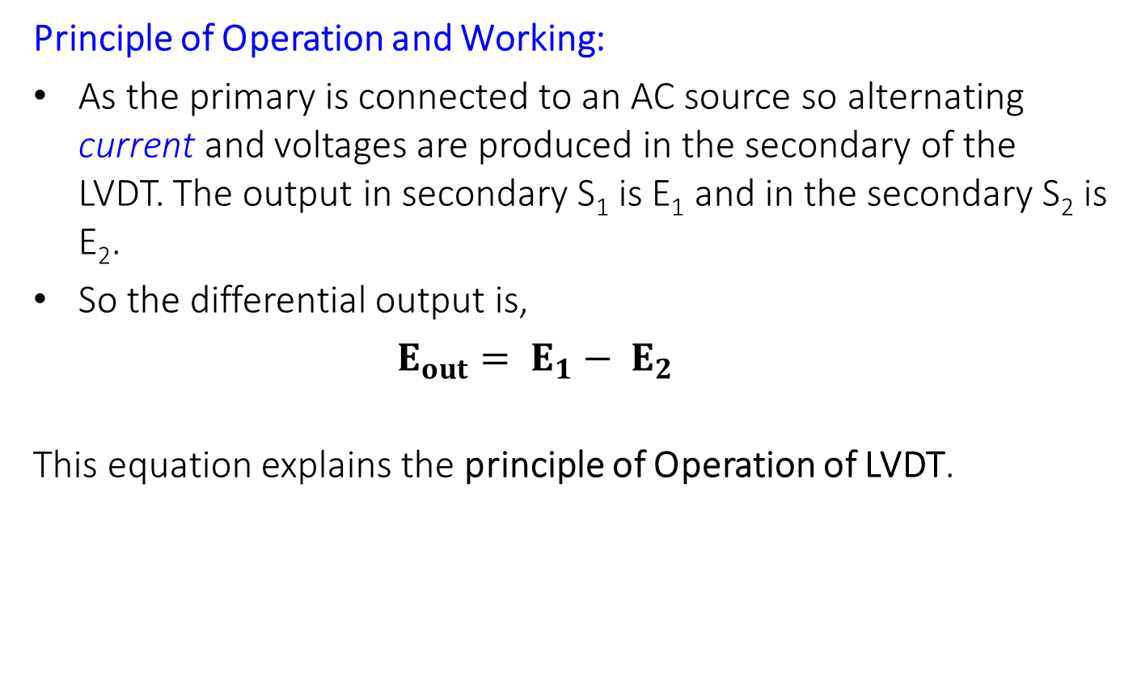
LVDT:
Principle of Operation and Working:
As the primary is connected to an AC source so alternating current and voltages are produced in the secondary of the LVDT. The output in secondary S₁ is E₁ and in the secondary S₂ is E₂.
So the differential output is,
$E_{out}= E_{1}− E_{2}$
This equation explains the principle of Operation of LVDT.

Slide 11
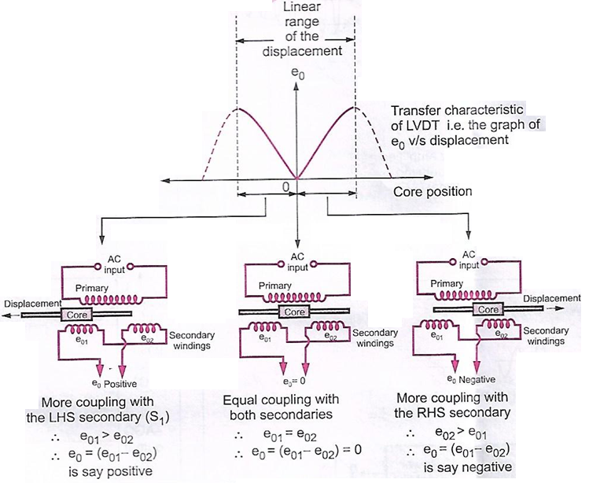
LVDT:

Slide 12
LVDT:
Now three cases arise according to the locations of core which explains the working of LVDT are discussed below as,
CASE I : (E_{out} = 0) - When the core is at null position (for no displacement) When the core is at null position then the flux linking with both the secondary windings is equal so the induced emf is equal in both the windings. So for no displacement, E_{out} = 0 as E₁ = E₂. So it shows that no displacement took place.
CASE II : (E_{out} = Positive) - When the core is moved to left of null position (For displacement to the upward of reference point) In the this case the flux linking with secondary winding S₁ is more as compared to flux linking with S₂. Due to this E₁ > E₂ => E_{out} is positive.
CASE III : (E_{out} = Negative) - When the core is moved to right of null position (For displacement to the upward of reference point) In the this case the flux linking with secondary winding S₂ is more as compared to flux linking with S₁. Due to this E₁ < E₂ => E_{out} is negative.
Output V_{S} Core Displacement A linear curve shows that output voltage varies linearly with displacement of core.

Slide 13
LVDT:
Advantages:
High Range – The LVDTs have a very high range for measurement of displacement. They can used for measurement of displacements ranging from 1.25 mm to 250 mm.
No Frictional Losses – As the core moves inside a hollow former so there is no loss of displacement input as frictional loss so it makes LVDT as very accurate device.
High Input and High Sensitivity – The output of LVDT is so high that it doesn’t need any amplification. The transducer possess a high sensitivity which is typically about 40V/mm.
Low Hysteresis – LVDTs show a low hysteresis and hence repeatability is excellent under all conditions
Low Power Consumption – The power is about 1W which is very as compared to other transducers.
Direct Conversion to Electrical Signals – They convert the linear displacement to electrical voltage which are easy to process
Disadvantages:
LVDT is sensitive to stray magnetic fields so it always requires a setup to protect them from stray magnetic fields.
LVDT gets affected by vibrations and temperature.
Applications:
We use LVDT in the applications where displacements to be measured are ranging from a fraction of mm to few cms. The LVDT acting as a primary transducer converts the displacement to electrical signal directly.
The LVDT can also act as a secondary transducer. E.g. the Bourbon tube which acts as a primary transducer and it converts pressure into linear displacement and then LVDT coverts this displacement into an electrical signal which after calibration gives the readings of the pressure of fluid.

Slide 14
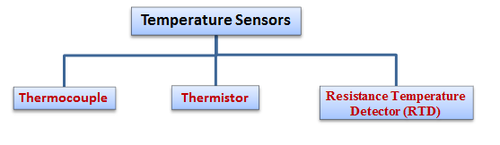
Temperature Sensor & its types
Temperature sensor: The sensor that change their output with change in temperature.
Example: Thermocouple, Thermistor, Resistance Temperature Detector (RTD)
Types of Temperature sensor:

Slide 15
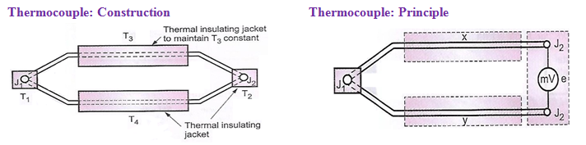
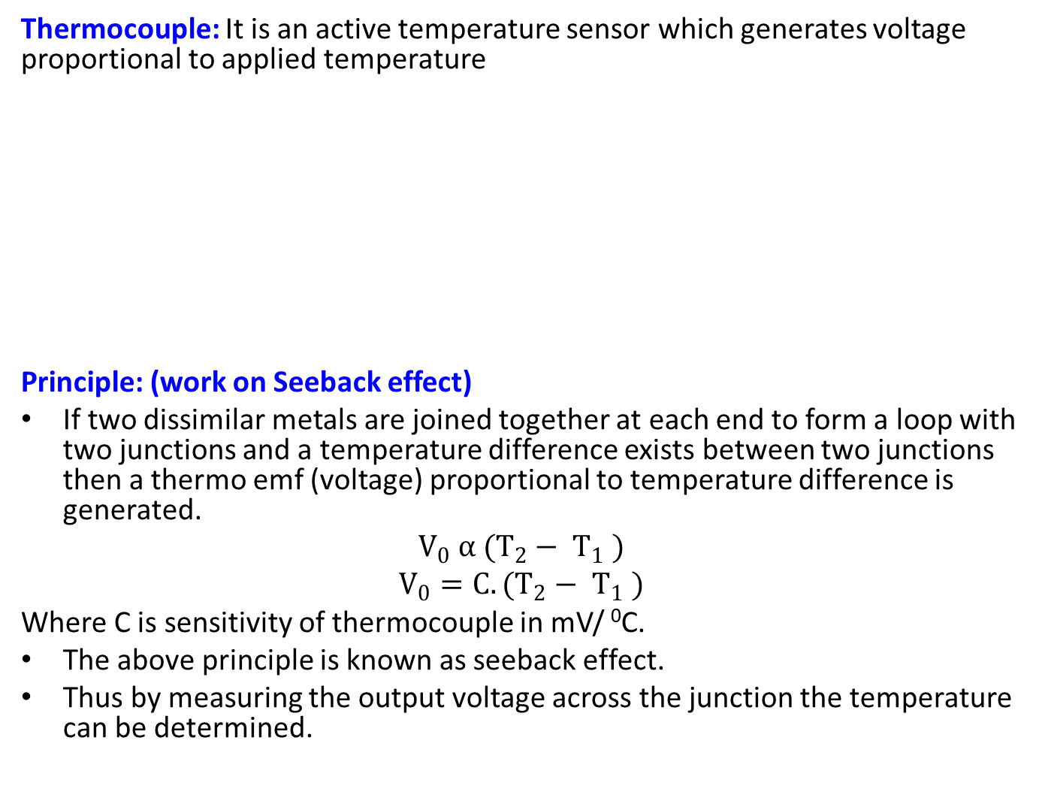
Temperature Sensor - Thermocouple
Thermocouple: It is an active temperature sensor which generates voltage proportional to applied temperature
Principle: (work on Seeback effect)
If two dissimilar metals are joined together at each end to form a loop with two junctions and a temperature difference exists between two junctions then a thermo emf (voltage) proportional to temperature difference is generated.
$$V_{0} α (T_{2}− T_{1} )$$
$$V_{0}=C.(T_{2}− T_{1} )$$
Where C is sensitivity of thermocouple in mV/ ⁰C.
The above principle is known as seeback effect.
Thus by measuring the output voltage across the junction the temperature can be determined.

Slide 16
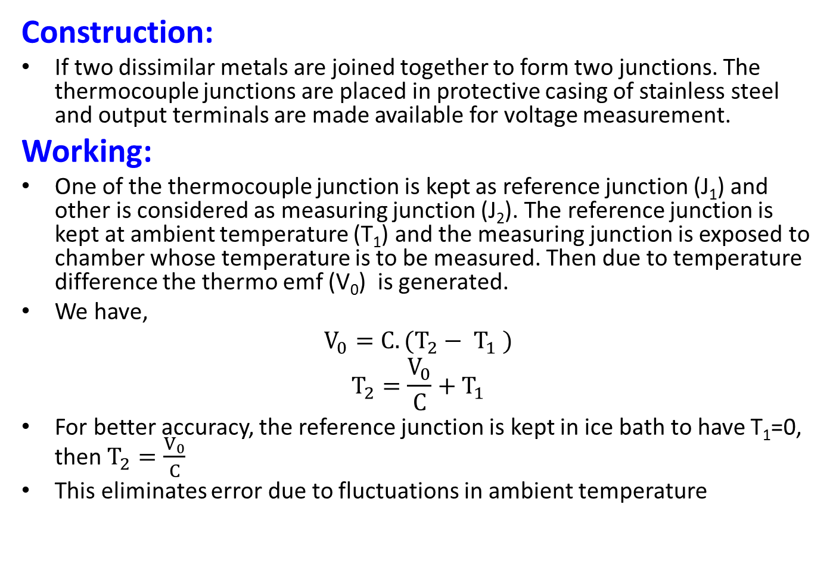
Thermocouple:
Construction:
If two dissimilar metals are joined together to form two junctions. The thermocouple junctions are placed in protective casing of stainless steel and output terminals are made available for voltage measurement.
Working:
One of the thermocouple junction is kept as reference junction (J₁) and other is considered as measuring junction (J₂). The reference junction is kept at ambient temperature (T₁) and the measuring junction is exposed to chamber whose temperature is to be measured. Then due to temperature difference the thermo emf (V₀) is generated.
We have,
$$V_{0}=C.(T_{2}− T_{1} )$$
$$T_{2}=\frac{V_{0}}{C}+T_{1}$$
For better accuracy, the reference junction is kept in ice bath to have T₁=0, then $T_{2}=\frac{V_{0}}{C}$
This eliminates error due to fluctuations in ambient temperature

Slide 17
Thermocouple:
Advantages:
External source not required.
Less expensive and compact in size.
Responds quickly to temperature changes.
High working range
Disadvantages:
Their performance is affected by stray magnetic fields.
The generated output voltage is very small therefore it needs amplification.
Maintaining the junction temperature stable is difficult.
Characteristics V₀ Vs Temp. is non-linear.
The thermocouple system requires periodic maintenance.
Application:
Cement manufacturing plants.
Tube mills.
Food industries, bakeries.
Heat treatment plants.
Semiconductor manufacturing plants.
Seamless pipes manufacturing plants.

Slide 18
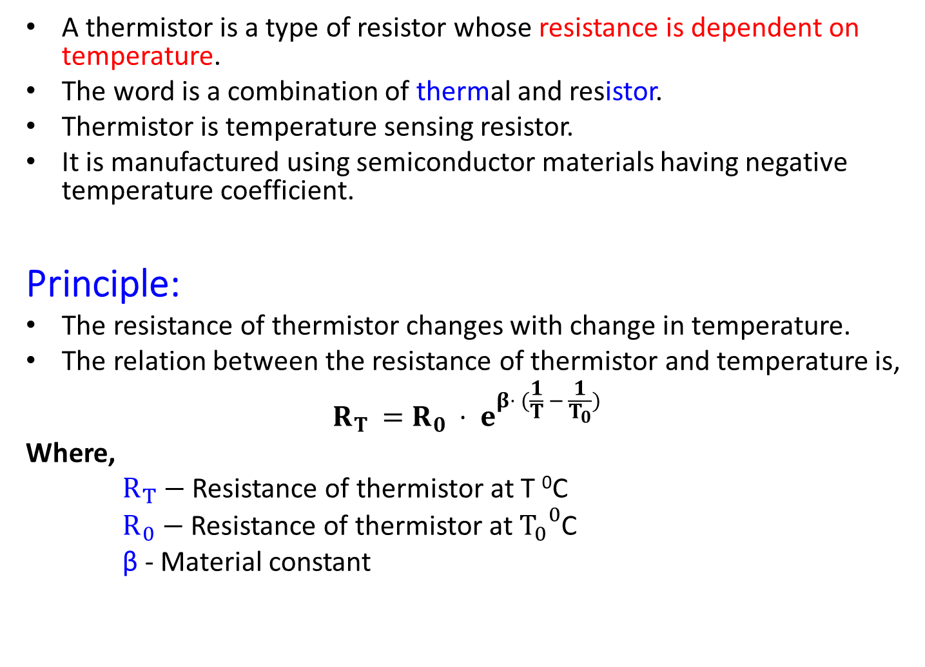
Temperature Sensor: Thermistor
A thermistor is a type of resistor whose resistance is dependent on temperature.
The word is a combination of thermal and resistor.
Thermistor is temperature sensing resistor.
It is manufactured using semiconductor materials having negative temperature coefficient.
Principle:
The resistance of thermistor changes with change in temperature.
The relation between the resistance of thermistor and temperature is,
$$R_{T }=R_{0 }⋅ e^{β⋅ (\frac{1}{T} − \frac{1}{T_{0}})}$$
Where,
$R_{T}−$Resistance of thermistor at T ⁰C
$R_{0}−$Resistance of thermistor at ${T_{0}}^{0}$C
β - Material constant

Slide 19
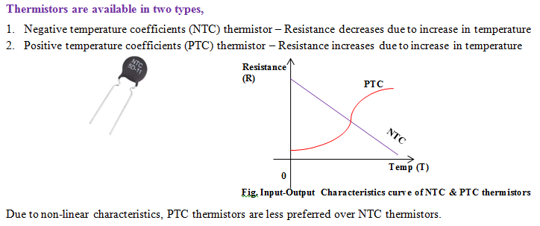
Thermistor:

Slide 20
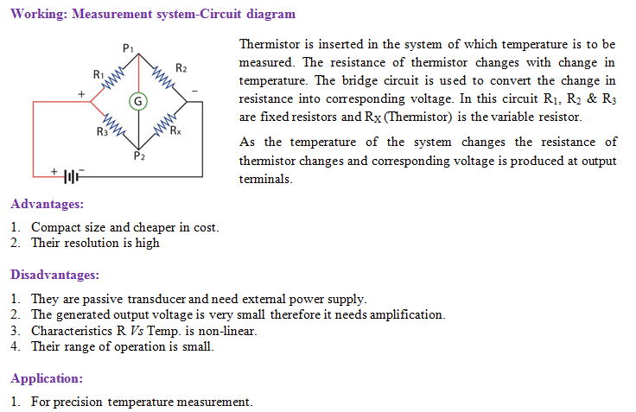
Thermistor:

Slide 21
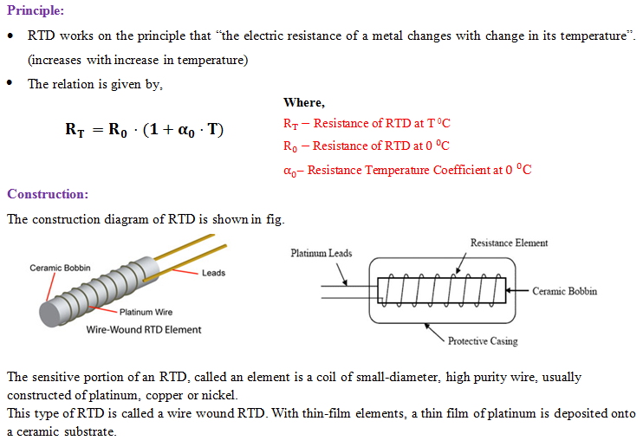
Temp. Sensor : Resistance Temperature Detector (RTD):

Slide 22
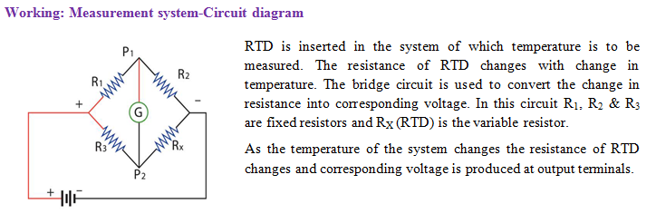
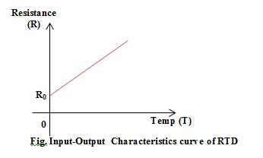
RTD:

Slide 23
RTD:
Advantages:
Due to no fluid present absolute temperature is recorded
It is highly sensitive and gives accurate results.
It has good range of temperature measurement.
High accuracy
Don’t need reference temperature.
Due to electrical output it can be used with PLCs and complete can be achieved
Disadvantages:
It needs external power supply.
Its size is not compact.
It has low resolution
Cost is high
Applications:
Air conditioning and refrigeration servicing
Food Processing
Textile processing
Plastics processing
Petrochemical processing
Air, gas and liquid temperature measurement in pipes and tanks
Exhaust gas temperature measurement

Slide 24
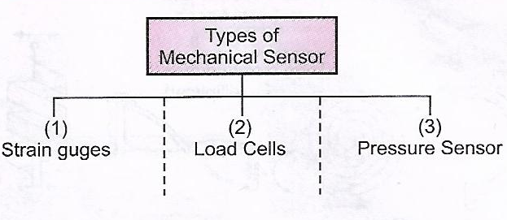
Mechanical Sensors: Types
Strain gauges: Types
Strain Gauge
Semiconductor Type
Resistive Type
Foil
Bounded
Unbounded

Slide 25
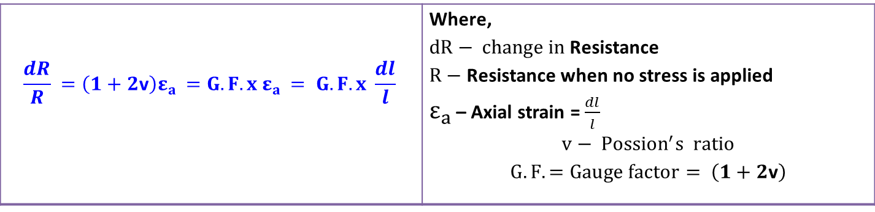
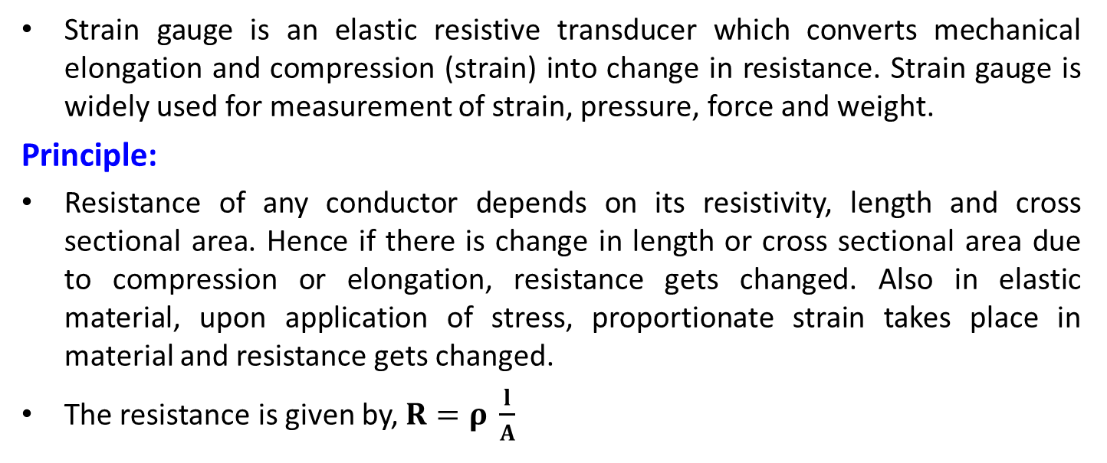
Strain gauges:
Strain gauge is an elastic resistive transducer which converts mechanical elongation and compression (strain) into change in resistance. Strain gauge is widely used for measurement of strain, pressure, force and weight.
Principle:
Resistance of any conductor depends on its resistivity, length and cross sectional area. Hence if there is change in length or cross sectional area due to compression or elongation, resistance gets changed. Also in elastic material, upon application of stress, proportionate strain takes place in material and resistance gets changed.
The resistance is given by,$R=ρ \frac{l}{A}$
$$\frac{dR}{R} =\left(1+2\text{v}\right)ε_{a }=G.F. {x ε}_{a }= G.F. {x \frac{dl}{l}}_{ }$$ | Where, $dR− change in$Resistance $R−$Resistance when no stress is applied $ε_{a }$– Axial strain = $\frac{dl}{l}$ $$v− {Possion}^{′}s ratio$$ $$G.F. =Gauge factor= \left(1+2\text{v}\right)$$

Slide 26
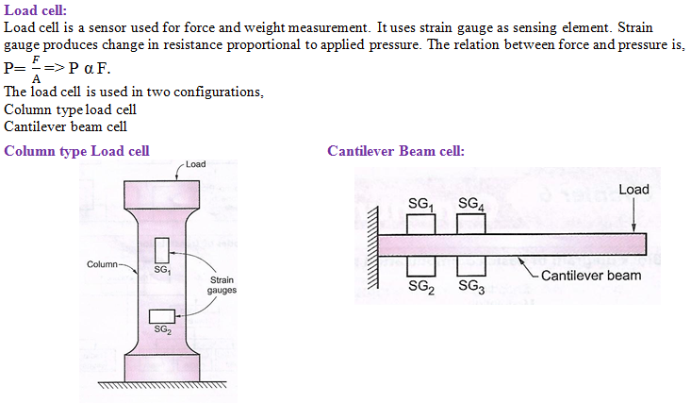
Load Cell:

Slide 27
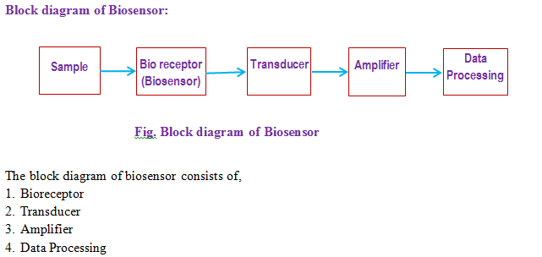
Biosensor:
Bisensor is a device which uses living organism or biological molecule (bioreceptor) to detect the presence of chemicals.
Principle:
A specific enzyme (type of bireceptor) or preferred biological molecule is deactivated.
The change in properties of biomaterial is related to chemical under detection.

Slide 28
Biosensor:
Explanation:
Bioreceptor: The bioreceptor is in the vicinity of sample. Depending on the sample and its concentration the properties of bioreceptor changes. The bioreceptor can be enzymes, tissues, microorganisms or chemoreceptors.
Transducer: The transducer converts one form of signal into another form. In this case the change in properties of bioreceptor is converted into electrical signal.
Amplifier: The electrical signals produced by the transducer are very weak. Hence the output of transducer is amplified by using amplifier.
Data Processing: The amplified electrical signal is calibrated against composition and concentration of sample.

